Slide 1
Process in unix
Create ; synchronize and exec commands

Slide 2
Process in Unix
The ps command shows basic information about the PCBs
PID time DESCRIPTION (CMD)
e.g. the man ps shows other command line arugments; e.g.
%cpu %CPU cpu utilization of the process in "##.#" format.
Currently, it is the CPU time used divided by the time the
process has been running (cputime/realtime ratio),
expressed as a percentage. It will not add up to 100%
unless you are lucky. (alias pcpu).
%mem %MEM ratio of the process's resident set size to the physical
memory on the machine, expressed as a percentage.
(alias pmem).

Slide 3
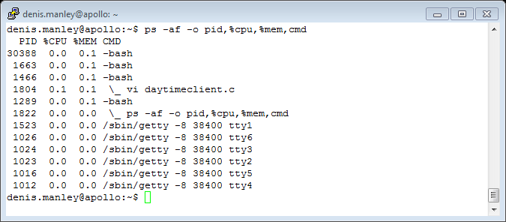
Example more detailed ps command

Slide 4
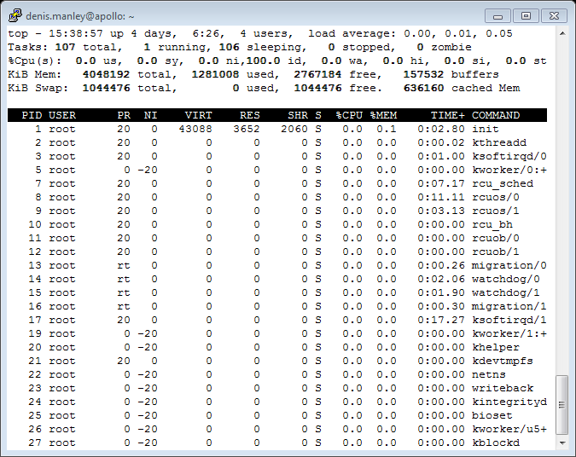
Top commands in linux: list of processes

Slide 5
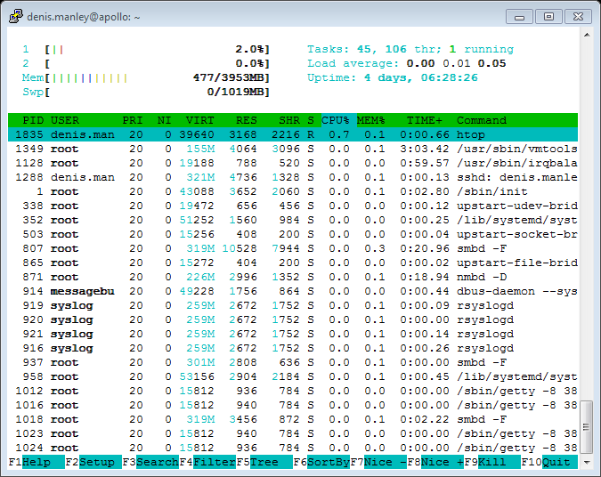
htop command in linux

Slide 6
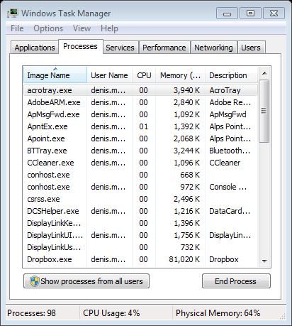
Process details in windows

Slide 7
Job and Process States
Status changes: as a job or process moves through the system
HOLD and placed in a queue (sometimes a priority queue
READY (job begins processing if enough resources available)
WAITING (can not continue until specific resource available e.g. i/o request
RUNNING: processing
FINISHED

Slide 8
Process Creation: Unix
In Unix, processes are created using fork()
Creates and initializes a PCB and creates a new address space
Initializes the address space with a copy of the entire contents of the address space of the parent
Initializes the kernel resources to point to the resources used by parent (e.g., open files)
Places the child PCB on the ready queue
Fork returns twice: Returns the child’s PID to the parent, “0” to the child

Slide 9
Process Creation
Address space
Child duplicate of parent
Child has a program (process) loaded into it
UNIX/Linux examples
The fork() system call in Unix creates a new process. After a successful fork() call, two copies of the original code will be running. In the original process (the parent) the return value of fork() will be the process ID of the child. In the new child process the return value of fork() will be 0

Slide 10
Synchronization
Fork()
UNIX command: generates one program from another program
Gives second program all first program attributes
code, global data, heap and stack, registers (including program counter), and open files.
Saves first program in original form
Splits program: two versions of the parent (parent and child)
Both run from statement after fork command
fork executed
“Process id” (pid) generated
Ensures each process has unique ID number

Slide 11
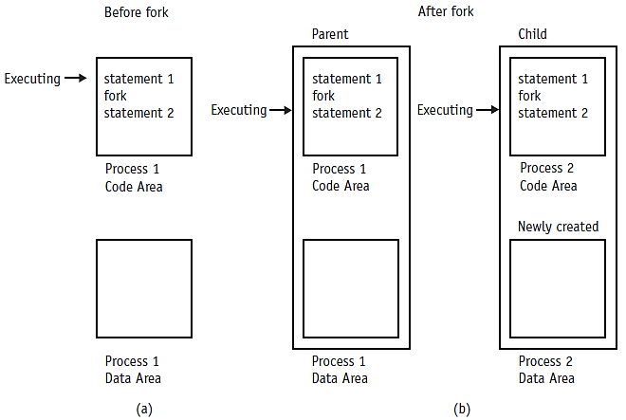
Synchronization (cont'd.)
when the fork command is received,
the parent process:
shown in (a) begets the child process shown
in (b) and Statement 2 (one of the child and one of the parent) is executed twice.
Cengage Learning 2014

Slide 12
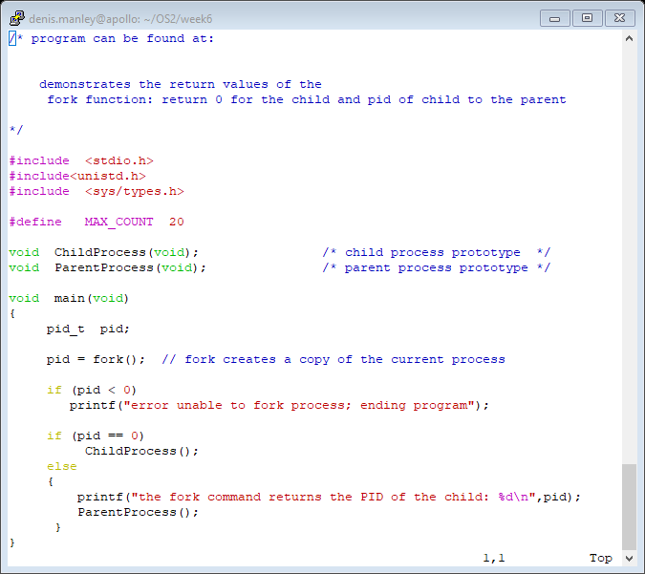
Fork1.c main

Slide 13
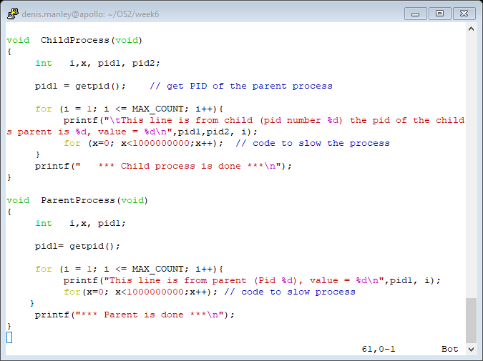
A simply program for fork: Fork1.c

Slide 14
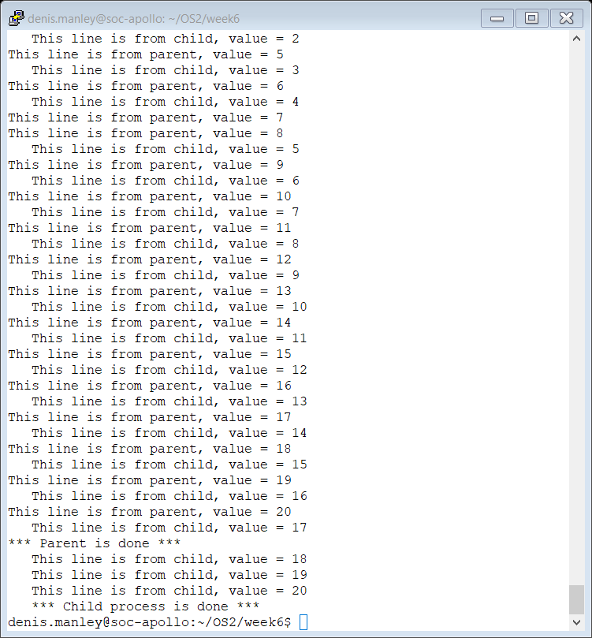
A sample Output Fork1.c

Slide 15
Modify Fork1.c
Reduce the number of iterations in the for loop: Fork1.c and Explain the effect.
Use ubuntu app/virtual machine and test the Fork1.c code: is it slower or faster?

Slide 16
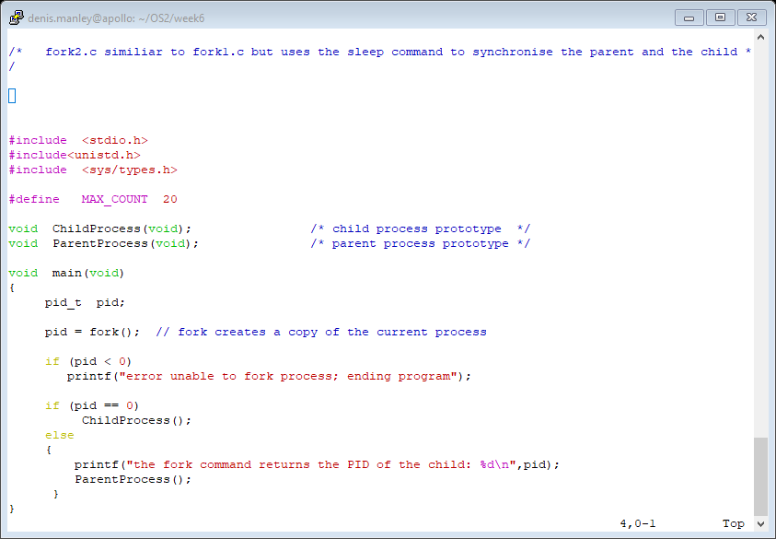
Fork2.c main function

Slide 17
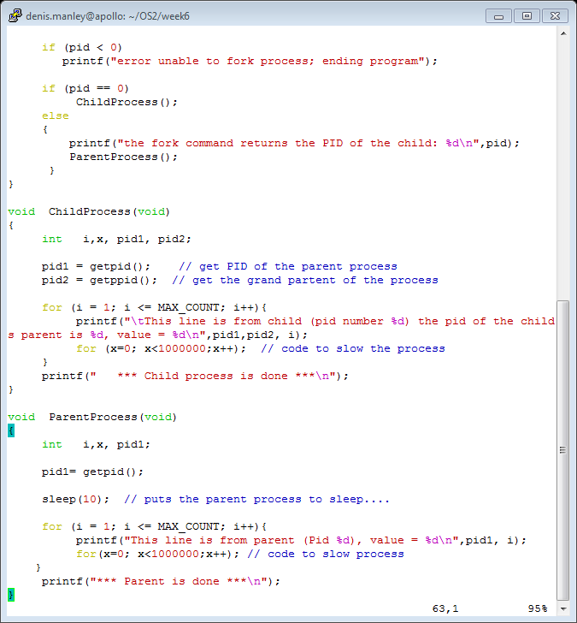
Fork2.c: Synchronise output with sleep() command:

Slide 18
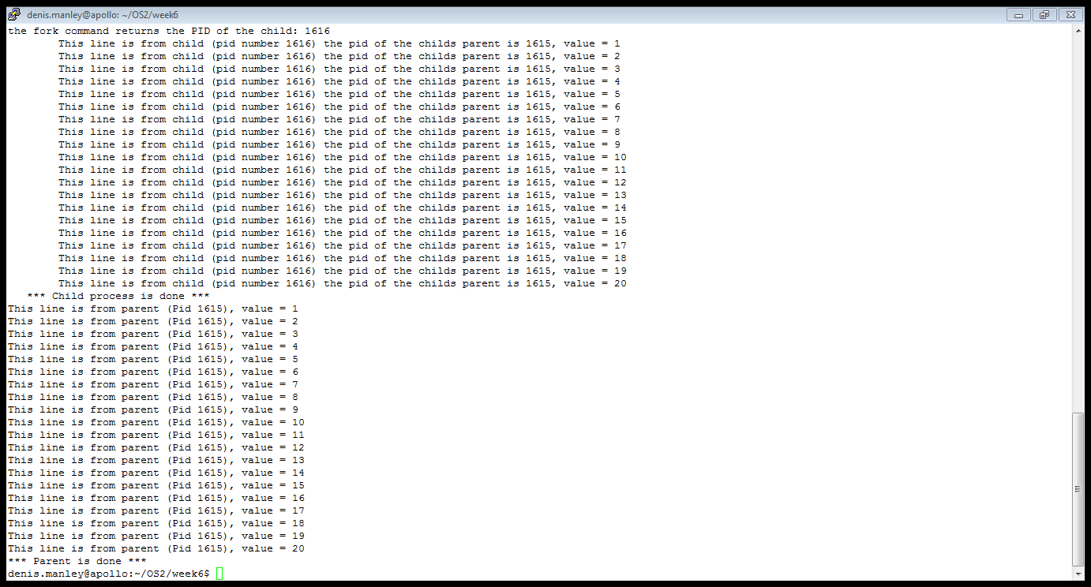
Fork2.c: Synchronise output with sleep command:
Change position of sleep command and observe the effect!!!!!

Slide 19
Synchronisation: Wait()
Wait()
A better way to ensure “synchronisation is using the “wait()” command.
UNIX command: synchronizes process execution
Suspends parent until child finished
Program IF-THEN-ELSE structure
Controlled by pid value
pid > zero: parent process
pid = zero: child process
pid < zero: error in fork call
Modify fork2.c program to use wait instead of sleep()

Slide 20
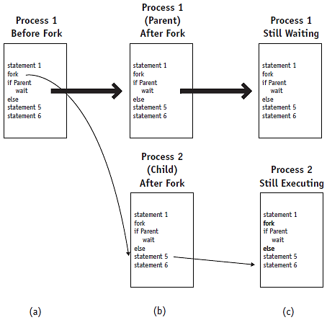
The wait command
The wait command used in conjunction with the fork command will synchronize the parent and child processes. In (a) the parent process is shown before the fork, (b) shows the parent and child after the fork, and (c) shows the parent and child during the wait.
© Cengage Learning 2014

Slide 21
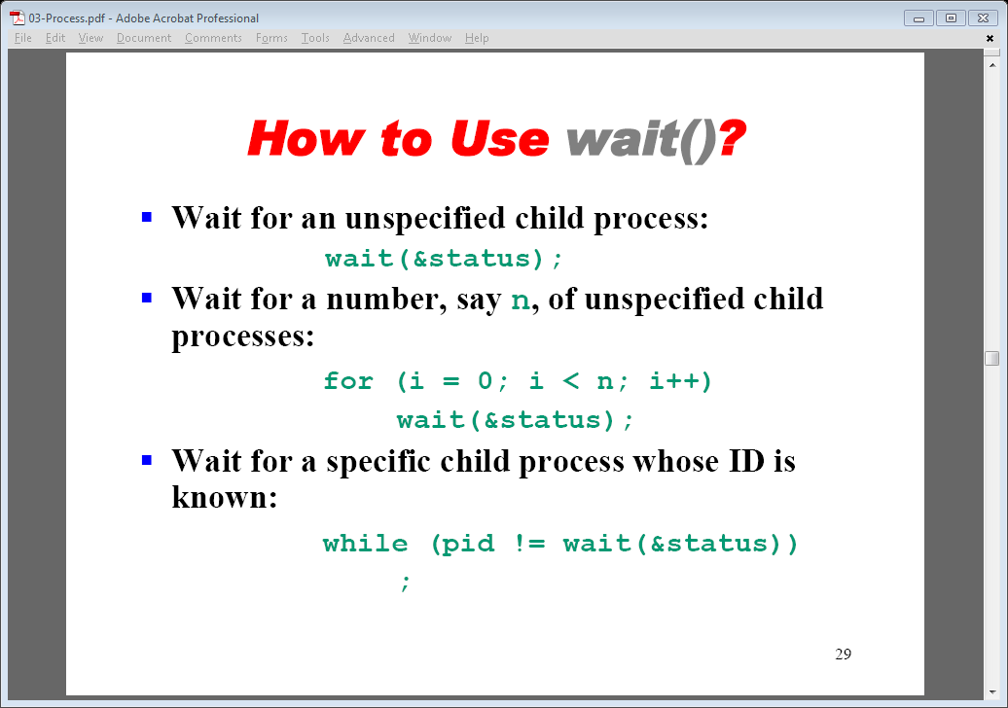
Using a wait()

Slide 22
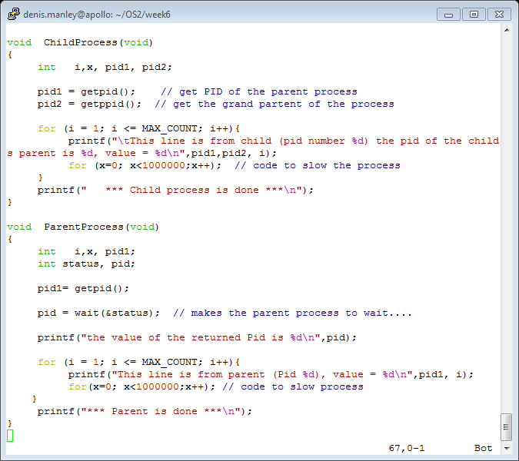
Sample code Fork3.c (Wait command)

Slide 23
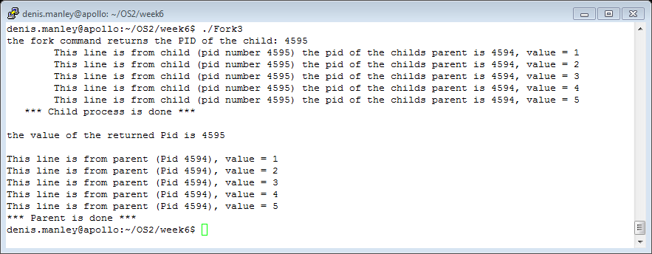
Execution of Fork3.c (MAX_COUNT = 5 )

Slide 24
int main(int argc, char **argv)
argc is a variable that contains the number of command line arguments
Argv is a character pointer array containing all the command line arguments.
argv[0] is the first command line argument
argv[1] is the second command line argument (if there is one…
If the command line (after the prompt) is:
cp file1 file2
what is the value returned by argv[2]?
What value is returned by argc?

Slide 25
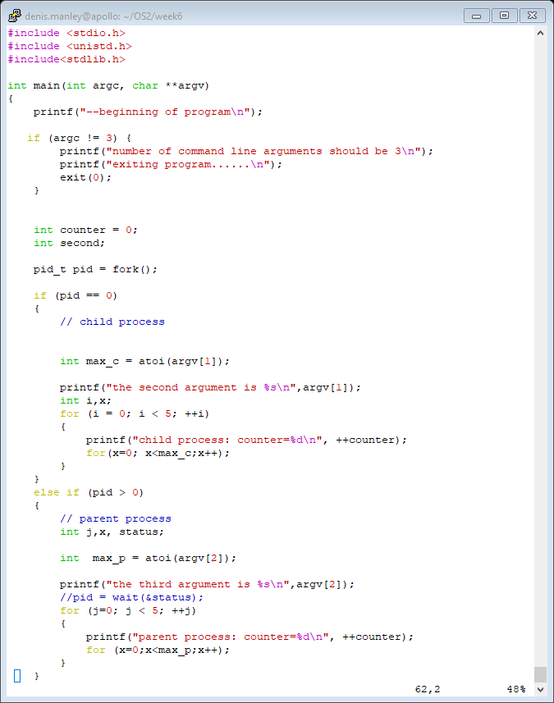
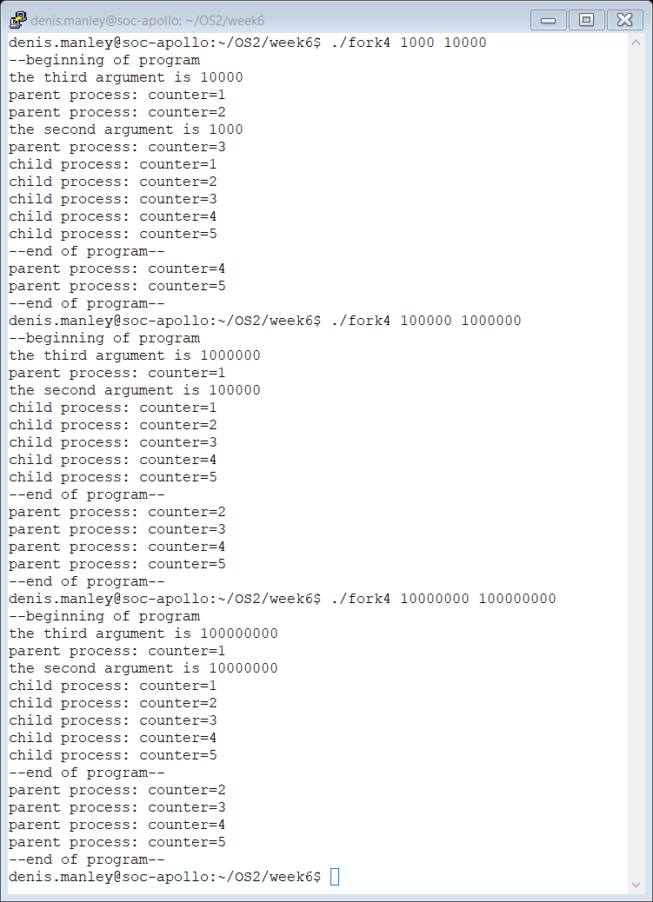
Pass command line arguments to c program: Fork4.c
If not wait the process may interleave iterations. Try with the wait command

Slide 26
Process Creation: Unix
How do we actually start a new program?
Use exec ((see man exec for more details)
Start new program execution from another program
E.g. int execvp(char *prog, char *argv[])
Stops the current process (e.g. child of prompt)
Loads the program “prog” into the process’ address space
Initializes hardware context and args for the new program
Places the PCB of it onto the ready queue

Slide 27
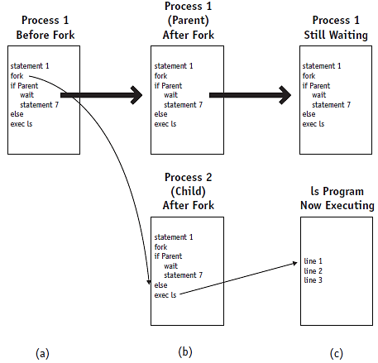
Synchronization (cont'd.)
The exec command is used, mostly, after the fork and wait combination. In (a) the parent is shown before the fork, (b) shows the parent and child after the fork, and (c) shows how the child process (Process 2) is overlaid by the ls program after the exec command.
© Cengage Learning 2014

Slide 28
The exec commands
The exec() system calls can be used after a fork() to replace the child process’ memory space with a new program
Successful exec call
Overlay second program over first
Only second program in memory
No return from successful exec call
Parent-child concept: does not hold
Create parent-child relationship
Call fork, wait, and exec in that order

Slide 29
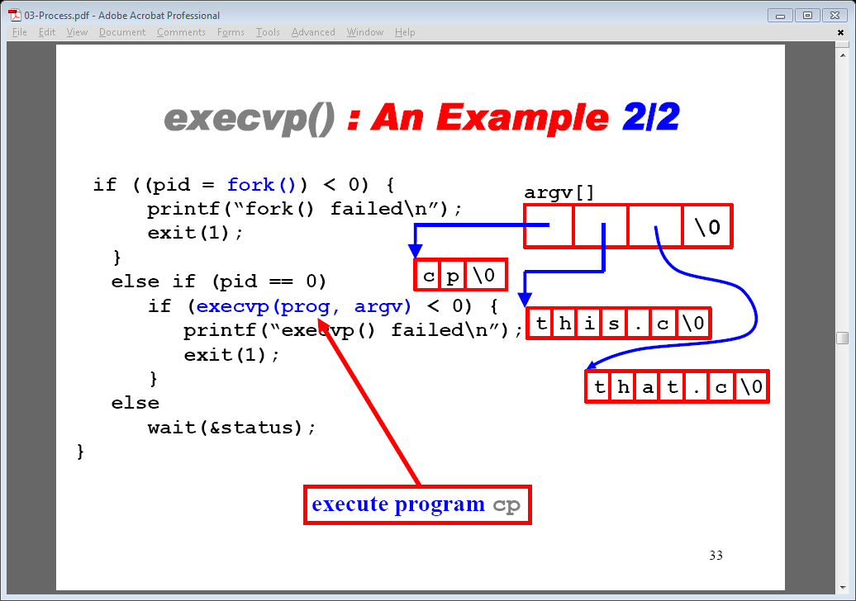
Example with fork(), exec() and wait()
Refer to execvp.c program; This program simulates a linux command line.

Slide 30
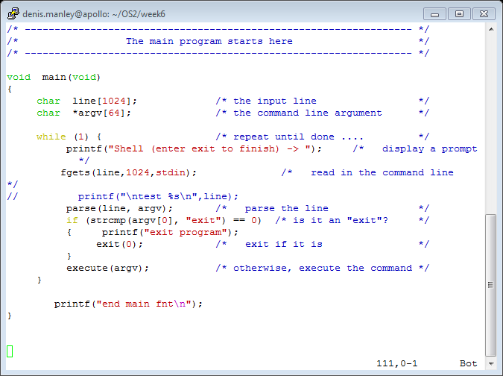
Main () for execvp program

Slide 31
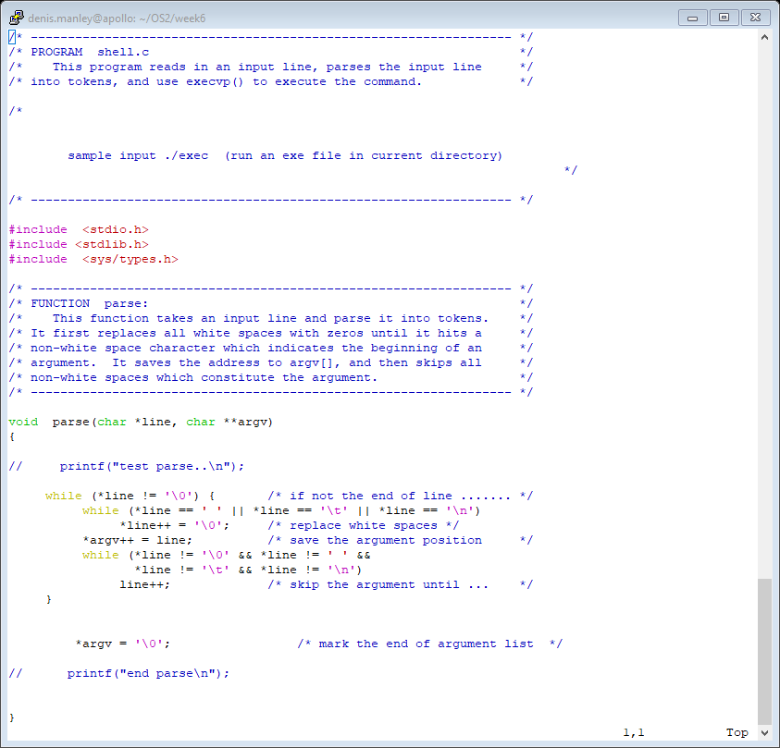
Parse function

Slide 32
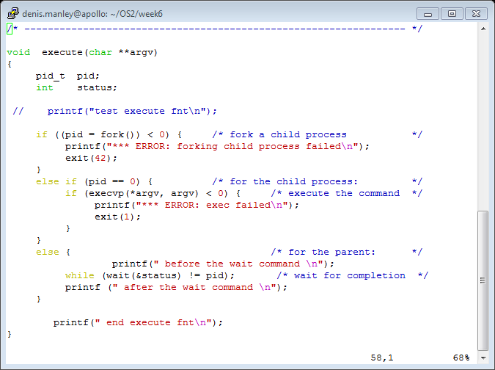
Execute function: equivalent to execvp()
argv: An array of strings implemented a array of char* : argv is **

Slide 33
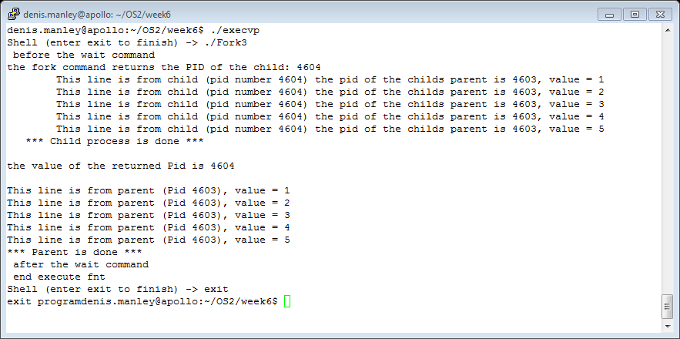
Sample output execvp.c: it uses exec() command to run the program ./Fork3. “Shell (enter exit to finish) is equivalent to the “linux prompt”.
remove wait command and see what happened: explain what is happening

Slide 34
Function heading
In the execvp function we have:
int execvp(char *prog, char *argv[])
These should not be confused with the
int main (int argc, char *argv[]).
The arguments in main refer to command line arguments:
argc is the number of command line arguments
Argv is an array of strings corresponing to the command line arguments: n.b. The program name is also a command line argument

Slide 35
Homework Exercise
Compile and Run the program fork1.c fork2.c fork3.c and fork4.c using the execvp program
Write a program that calls the fork command twice and each child will run a different functions e.g. child one calculates the cube of a command line argument and child two calculates the factorial of the 3rd commandline argument. You will need to use the wait command to synchronise output.: refer to fork3.c wait command

